Slide 1
About Ourselves
Computer Science majors
Experienced tutors
Passionate about teaching
David and Brian Hungerman
Notes:
Hello everyone. Before we begin, can we get a show of hands: how many of you have programmed before? Even one line of code? Okay… Okay...
That’s pretty good. Anyways, I’m Brian Hungerman-- and I’m David Hungerman-- A little background information about us: We’ve both worked as tutors teaching all levels of computer science from elementary school to college.

Slide 2
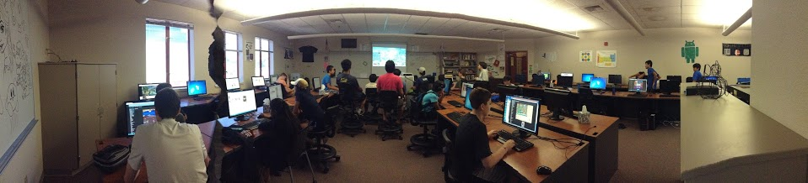
Running Our Summer Camp
Notes:
This is a little panorama I took. This is our Computer Science Summer Camp that David and I teach for. This camp gives us the opportunity to work one-on-one with primarily middle-school students as they start learning their first programming language. This experience has let us hone in on the pitfalls that many new programmers face (especially young ones).

Slide 3
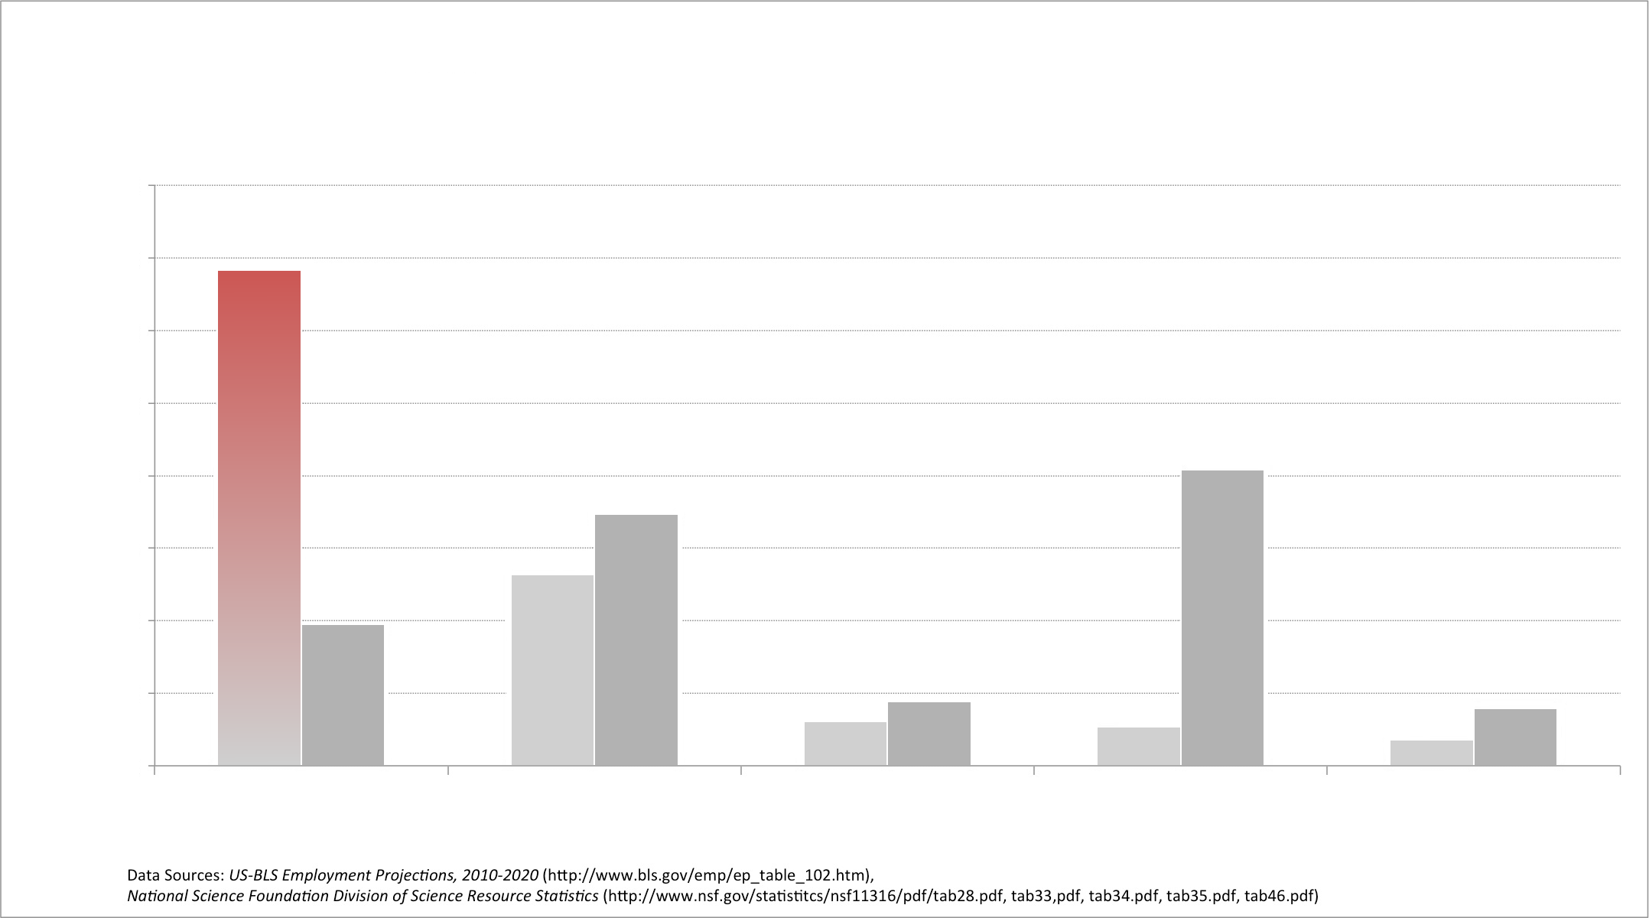

Annual STEM Job Openings vs College Graduates
160,000
140,000
Jobs
120,000
100,000
Demand for CS
80,000
Grads
60,000
Grads
40,000
Jobs
Grads
20,000
Jobs
Grads
Jobs
Grads
0
Jobs
Computing
Engineering
Physical Sciences
Life Sciences
Mathematics
Notes:
Let’s look at the bigger picture. Right now, 62% of STEM jobs are in computer science.
Out of all the STEM fields, computer science is the only one where more jobs are being created annually than there are graduates graduating.
As you can see, this graph illustrates just how large that demand is.

Slide 4
Modern Academia Is Teaching CSE Wrong
Notes:
Well, as we have both witnessed firsthand, how schools go about teaching computer science is simply ineffective. People are turned off at first exposure, and many don’t see it for the fun, rewarding experience that it actually is. So what’s wrong with it?

Slide 5
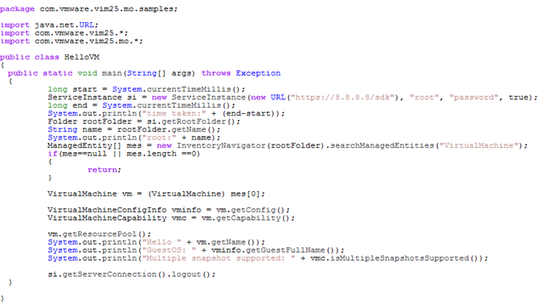
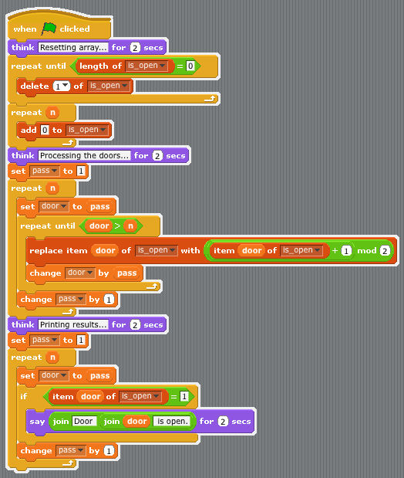
Current Ways To Learn:
Notes:
? How many people here have heard of Java? -- Okay.
Java is many people’s first programming language.
But while they are supposed to be learning higher level programming concepts, they often get bogged down in syntax, symbols, and red error messages.
Java is very powerful, but it has such a steep learning curve, for many newcomers, its not only difficult, its offputting.
Here’s some code written in an IDE. As you see, it looks a lot like notepad, and for a newcomer, it can be very intimidating.
Students are supposed to be learning programming concepts, but will often get bogged down in syntax, symbols, and red error messages.
IDEs can be very powerful, but there is such a steep learning curve to them, for many newcomers, it’s not only difficult, it’s off putting.
But teachers have noticed this issue and offered a solution:
? How many have heard of Scratch? -- Okay.
Scratch seeks to ease the learning curve of computer science.
As you can see, its very block and colorful- designed to appeal to a younger audience.
But it struggle to convey higher level programming concepts and does not properly prepare students for higher level languages.
Scratch is an interesting program that’s being used primarily for middle school computer science classes. Its very simple with a drag-and-drop environment. And as you can see with the example up there, it’s also very colorful and blocky- again appealing to a younger audience. And while it’s easy to use, it fails to get kids up to speed with actual programming concepts. And really, even if someone masters Scratch, they’ll still need to learn how to use an IDE down the line.
Javas too hard, scratch is too sugar coated. If only….
If only there was some sort of middle ground where students could learn programming concepts while not being overwhelmed by syntax.

Slide 6
Enter “Iterate();”
The Rosetta Stone of Programming
Notes:
Enter Iterate, the Rosetta Stone of Programming.

Slide 7
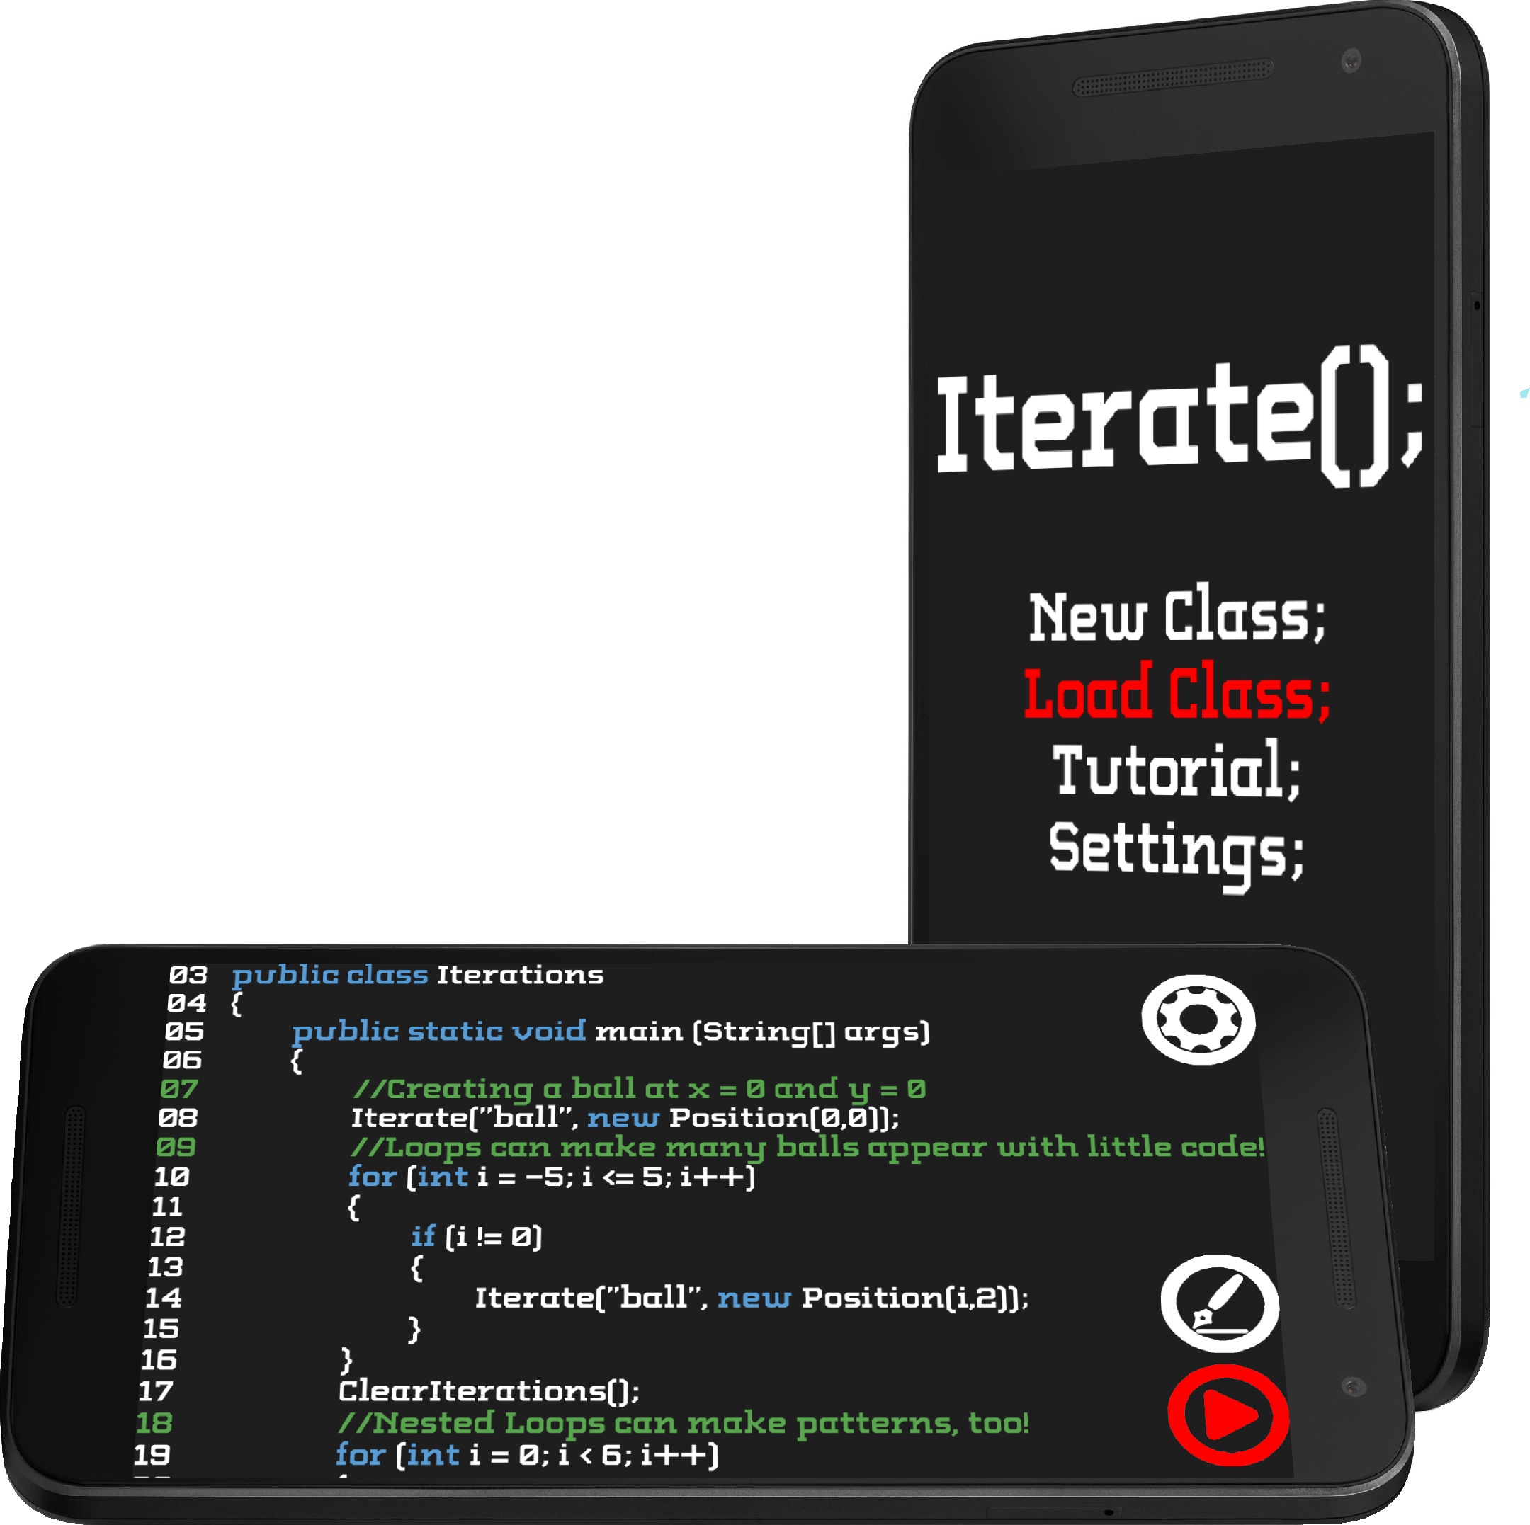
What is it?
Iterate puts the best aspects from multiple outdated systems into one well-rounded package
Notes:
Iterate is an educational app that teaches programming, taking the practical knowledge of Java and combining it with the ease of use of Scratch. In essence, it takes the best from both worlds and combines it into one well-rounded package.

Slide 8
What does it do?
Iterate provides a guided experience where students/hobbyists can digest computer science
Notes:
Iterate streamlines past the grittiness of syntax in favor of a more visual, guided experience while still teaching advanced concepts. Let’s see how that works:
Coding with Iterate, there is no such thing as an error: only unexpected results. This is inspired from our summer camp: when we helped kids code their games. For example, if we were helping them write code to move their player around the screen, an typo might cause the player to fly around like crazy, or spasm out uncontrollably. These sorts of errors were almost comical for the middle schoolers, but more importantly, they could be used as a sort of learning experience. Since they weren’t put off by errors (if anything they were enthralled by them), it encouraged them to really analyse their code to find out what went wrong. This sort of passion -- visualizing the debugging process has been a major focus as David and I have developed Iterate.

Slide 9
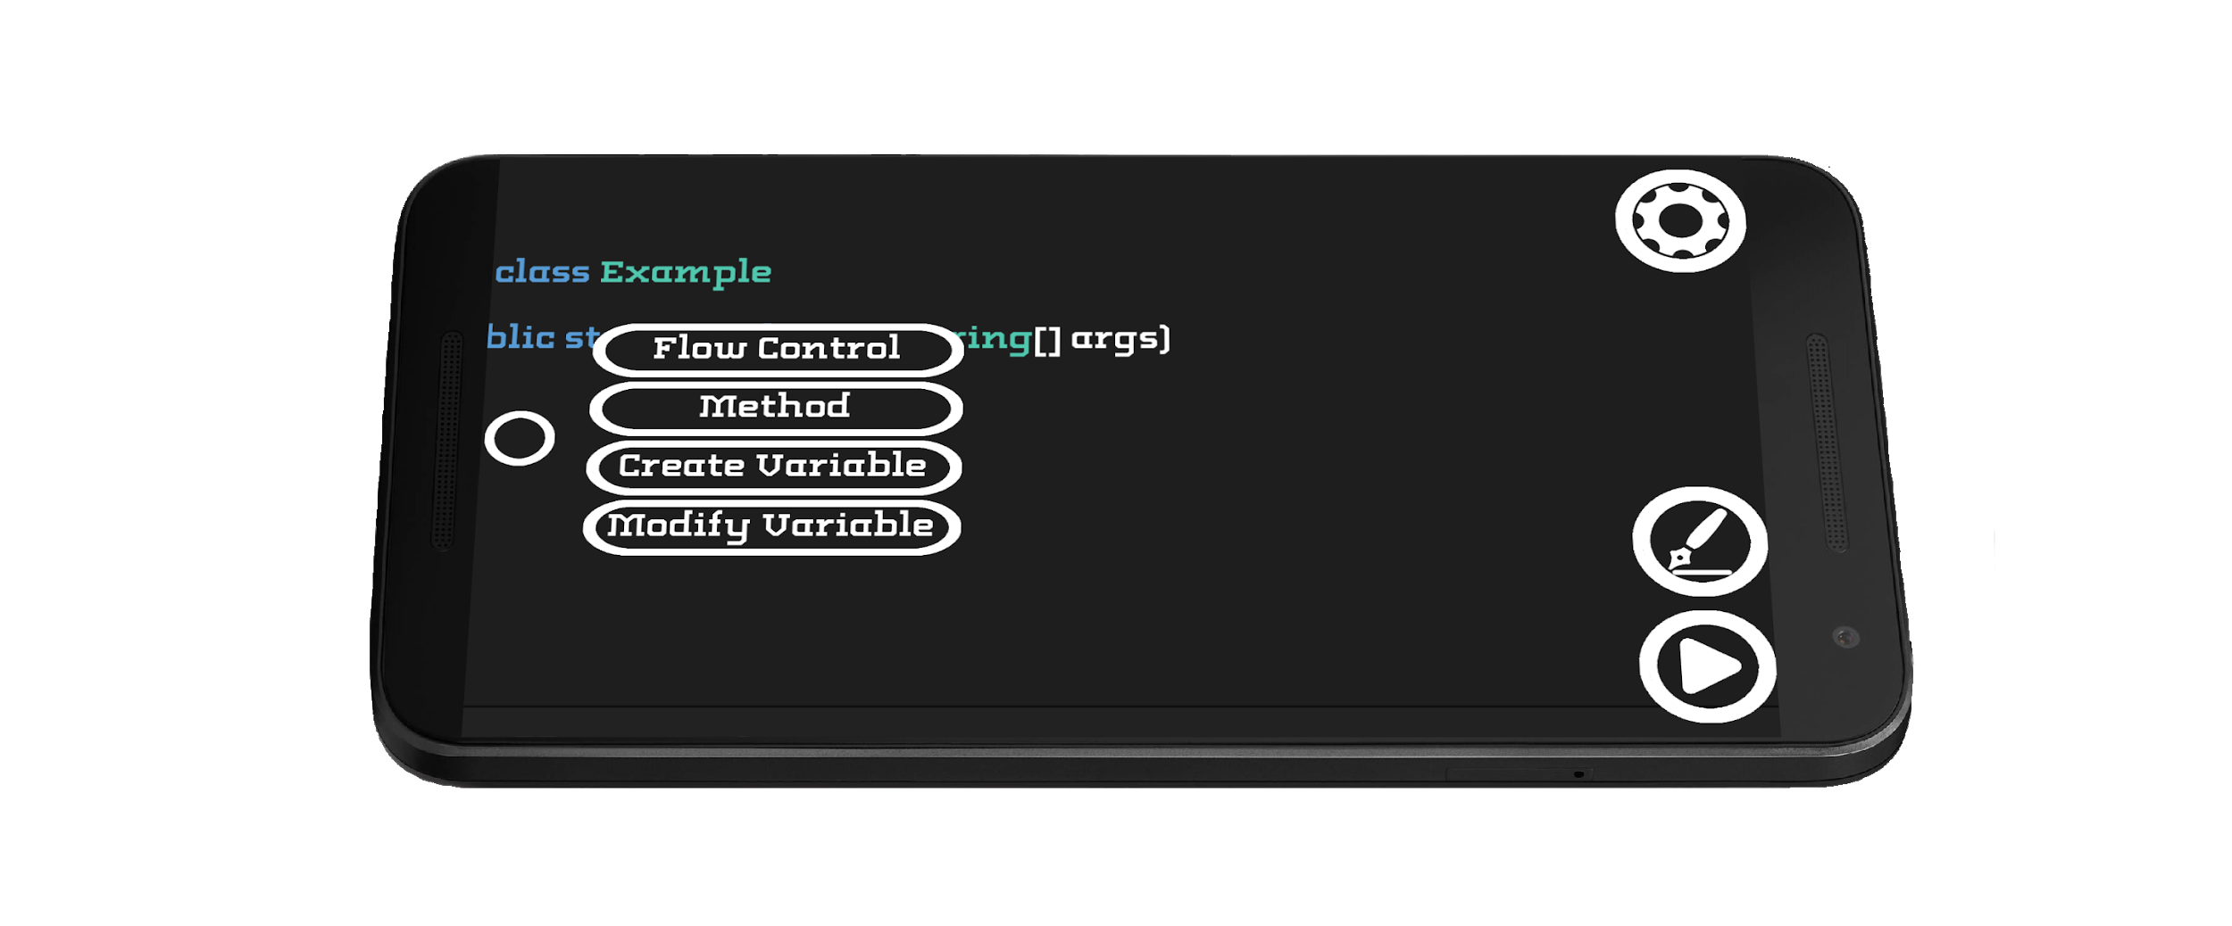
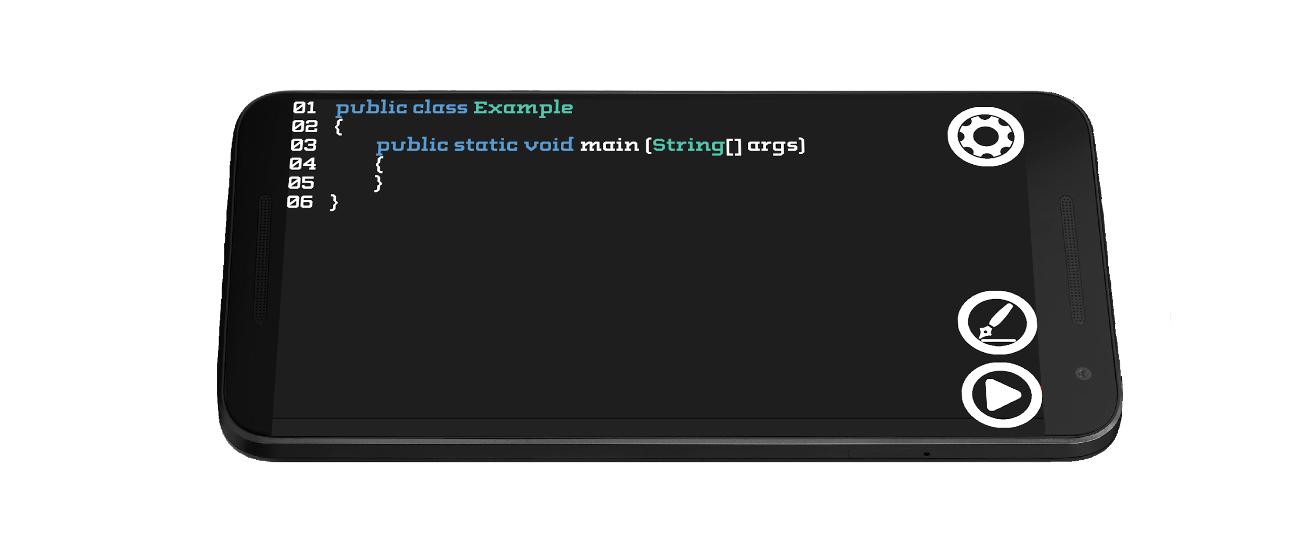
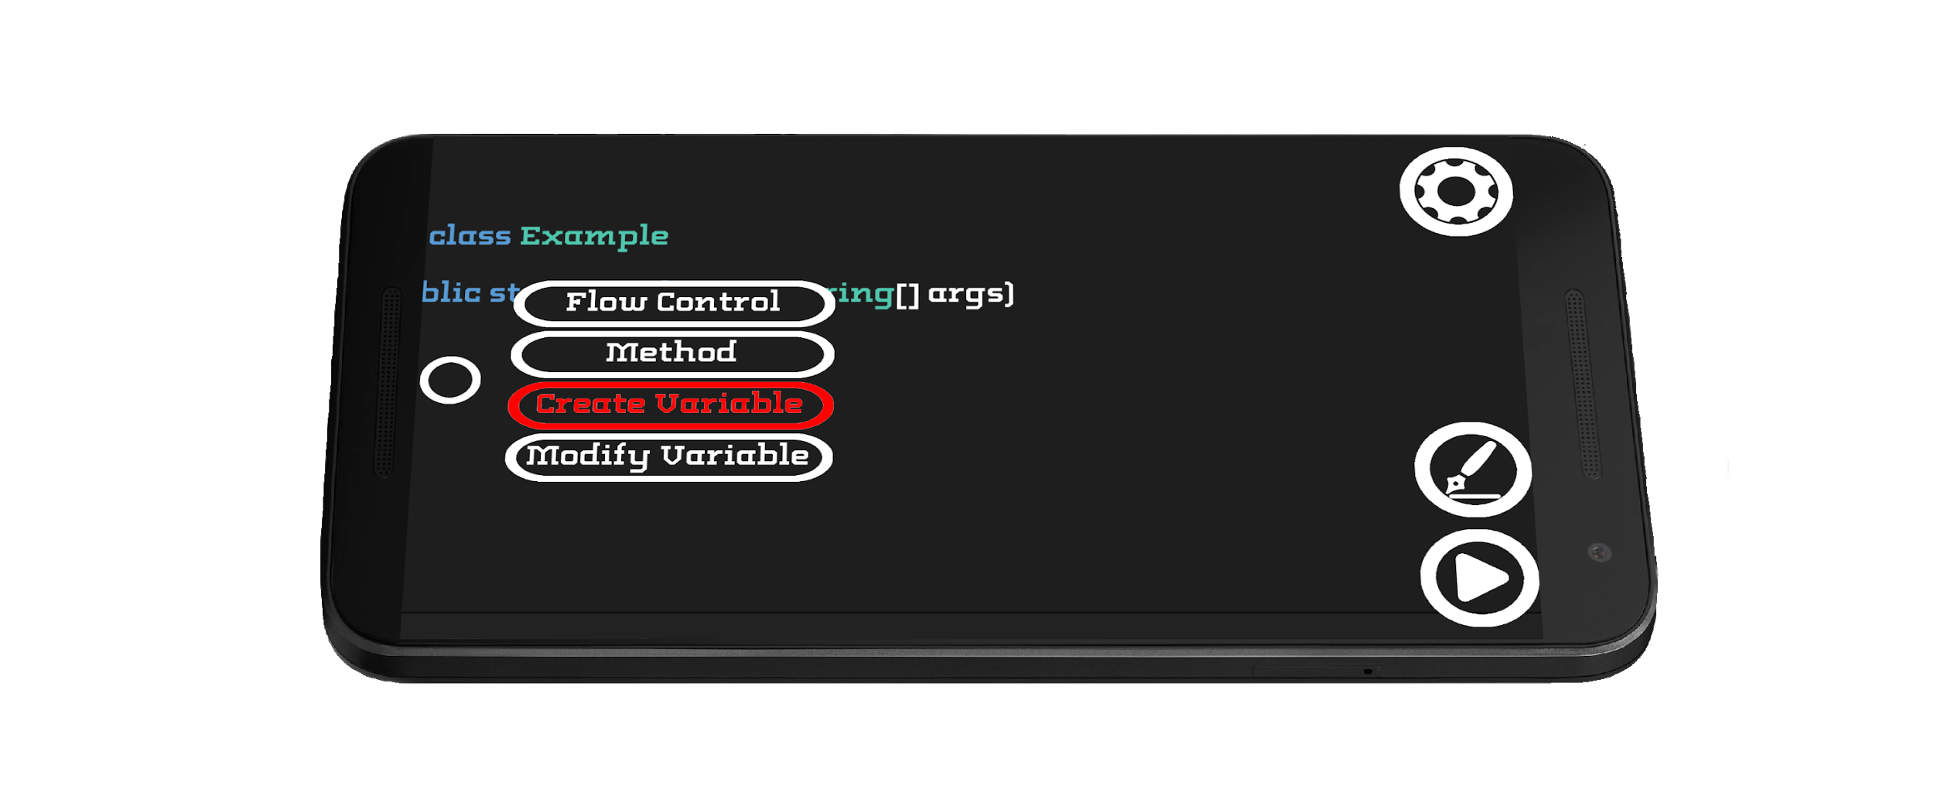
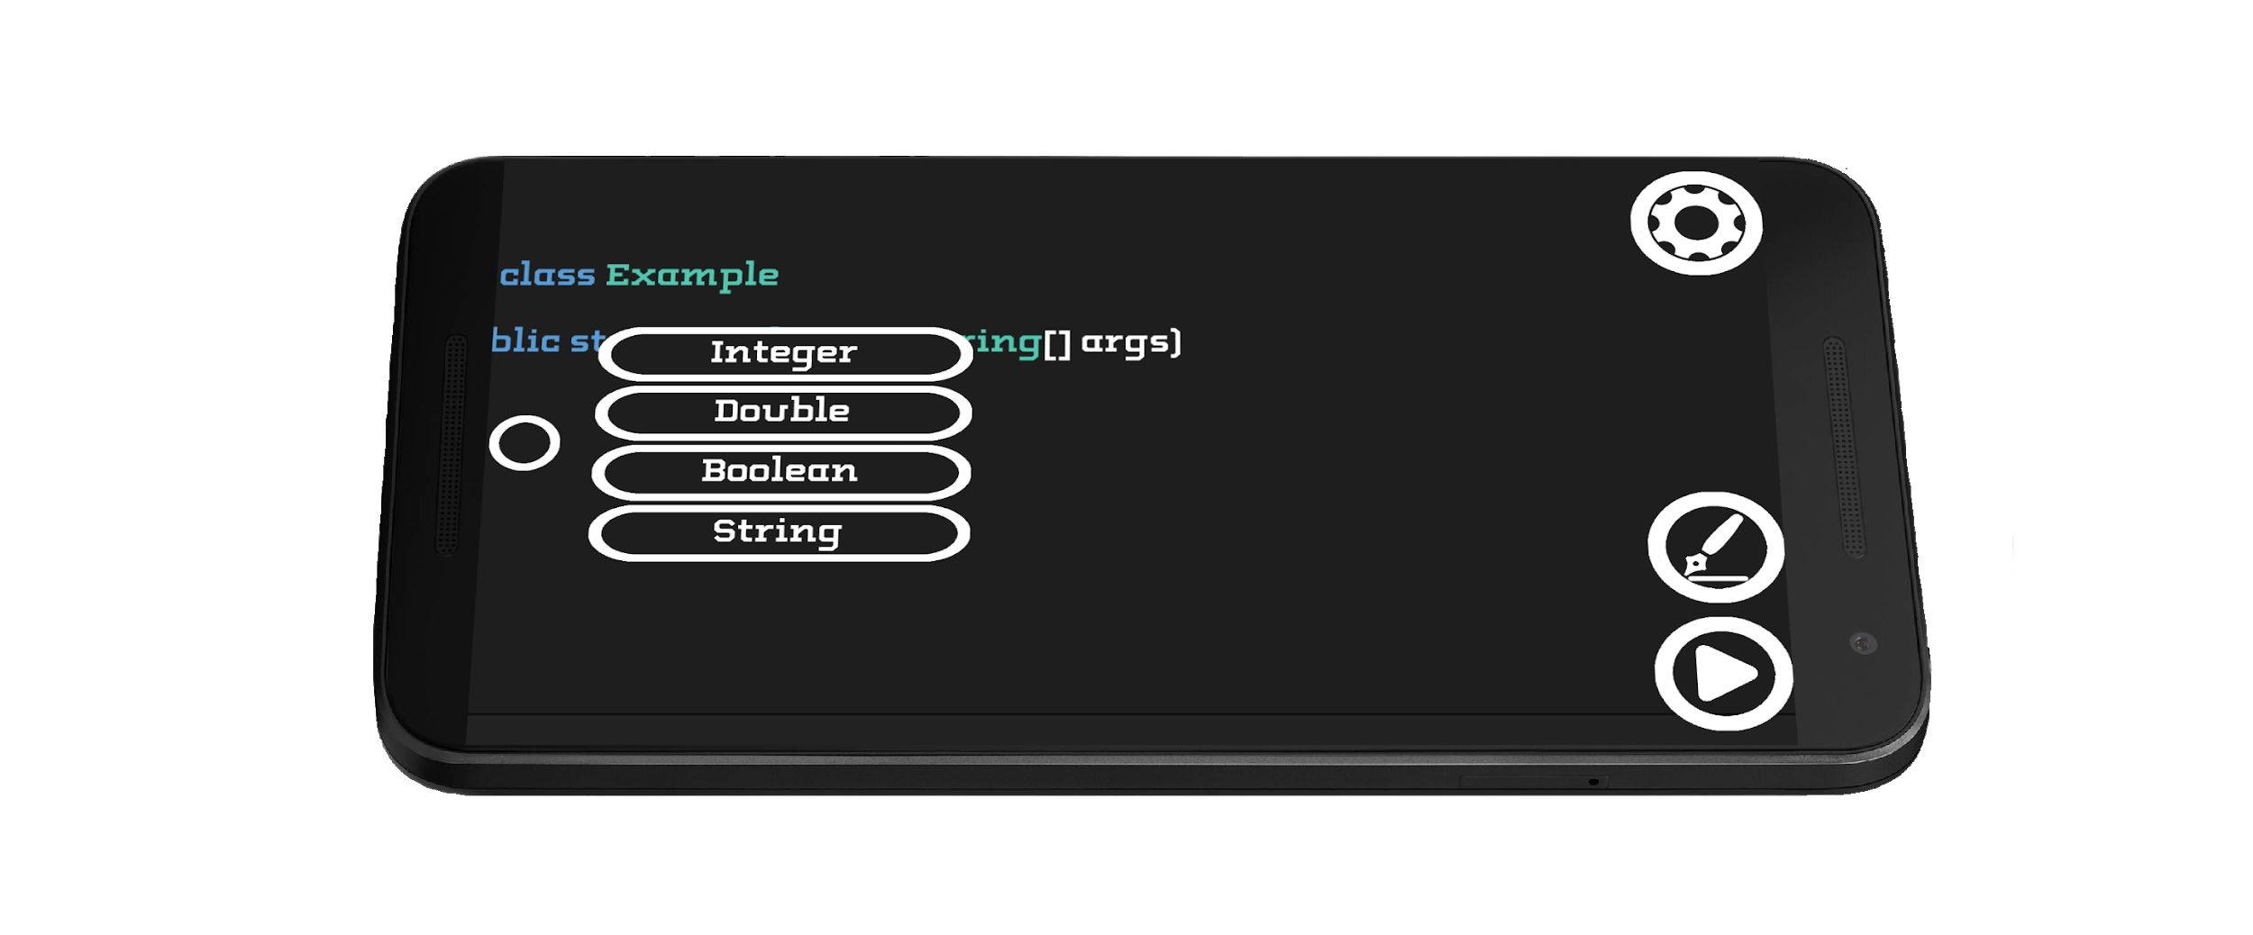
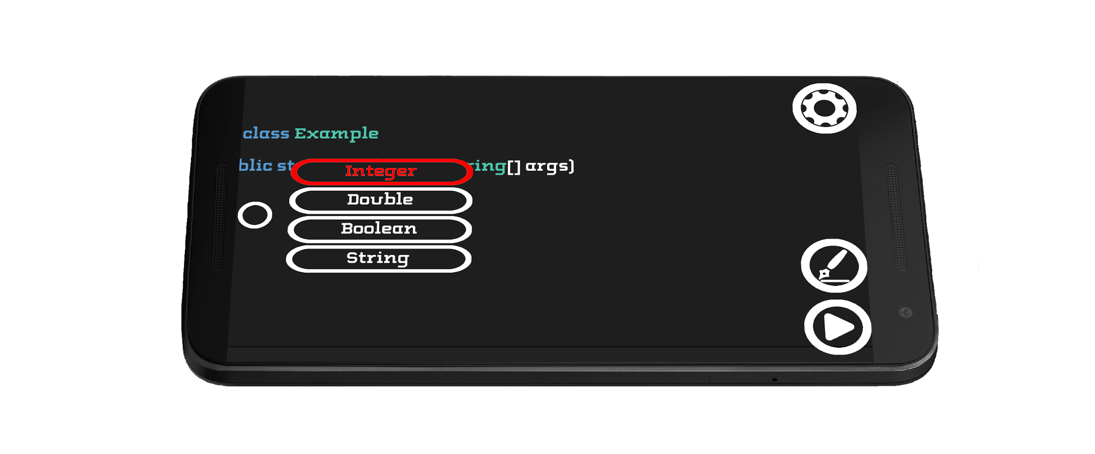
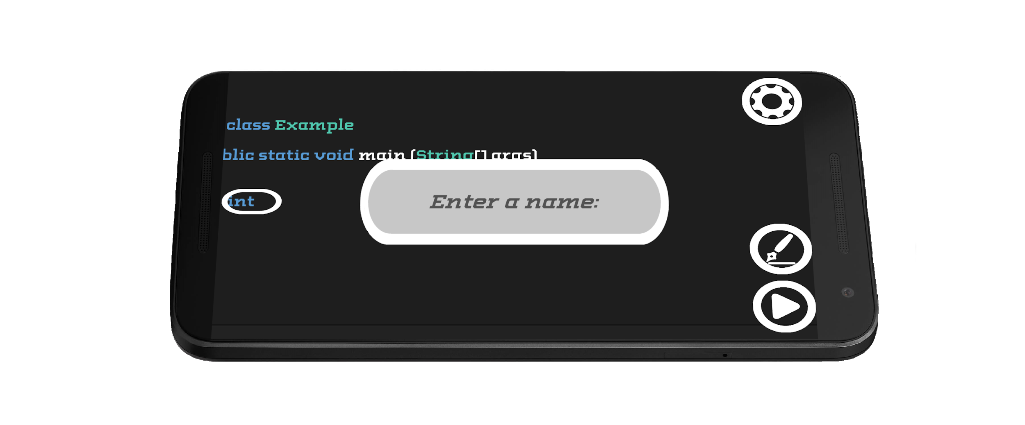
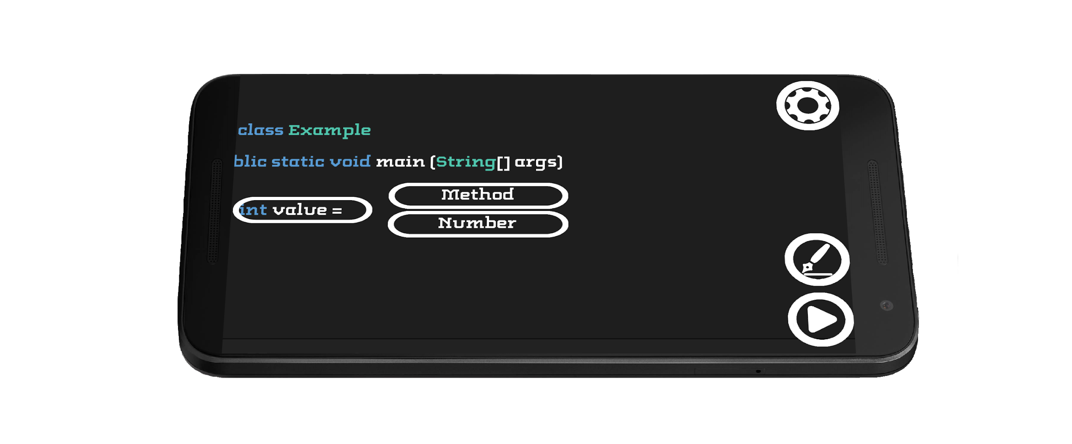
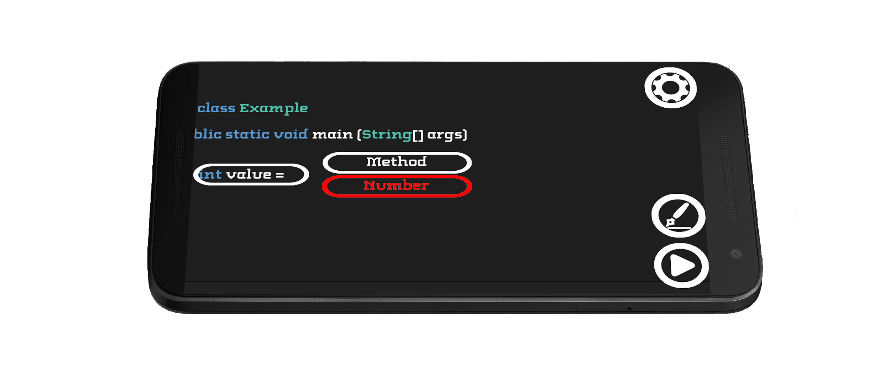
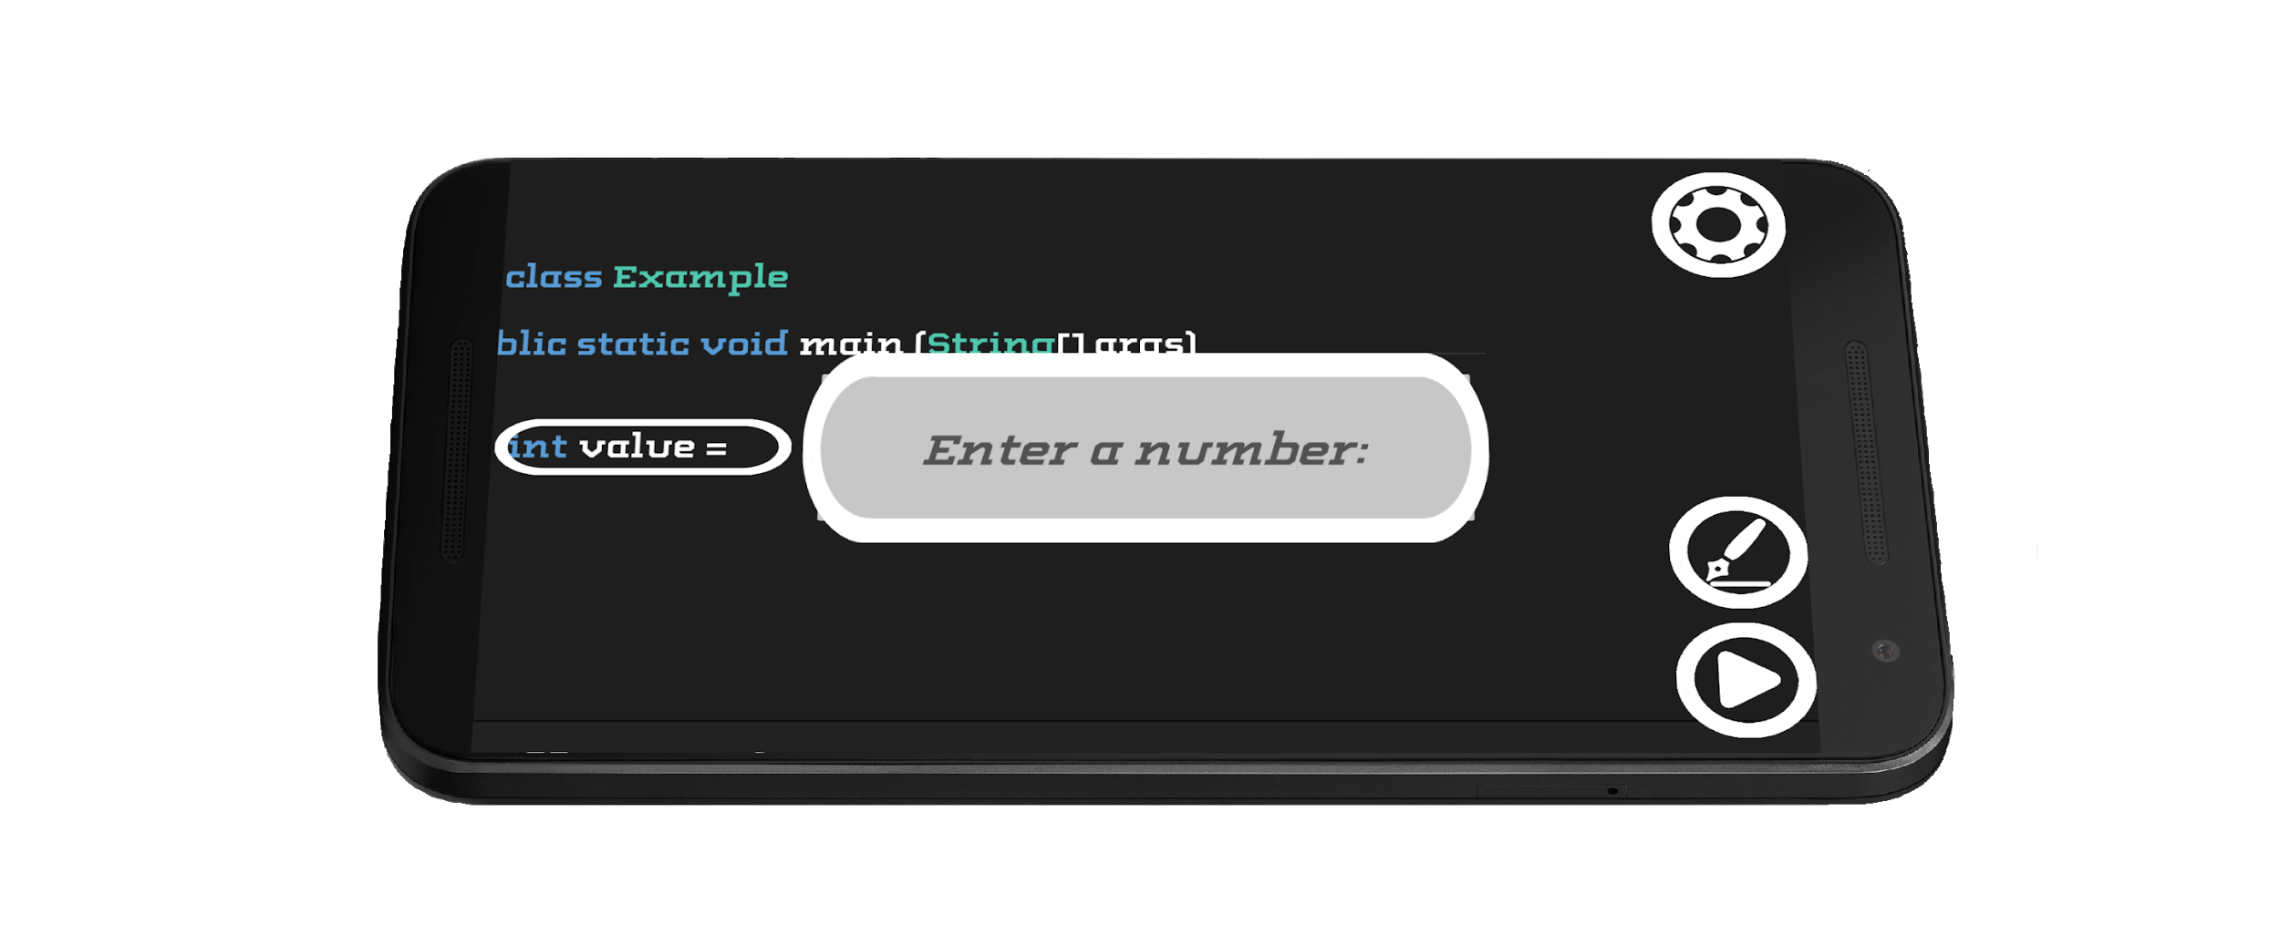
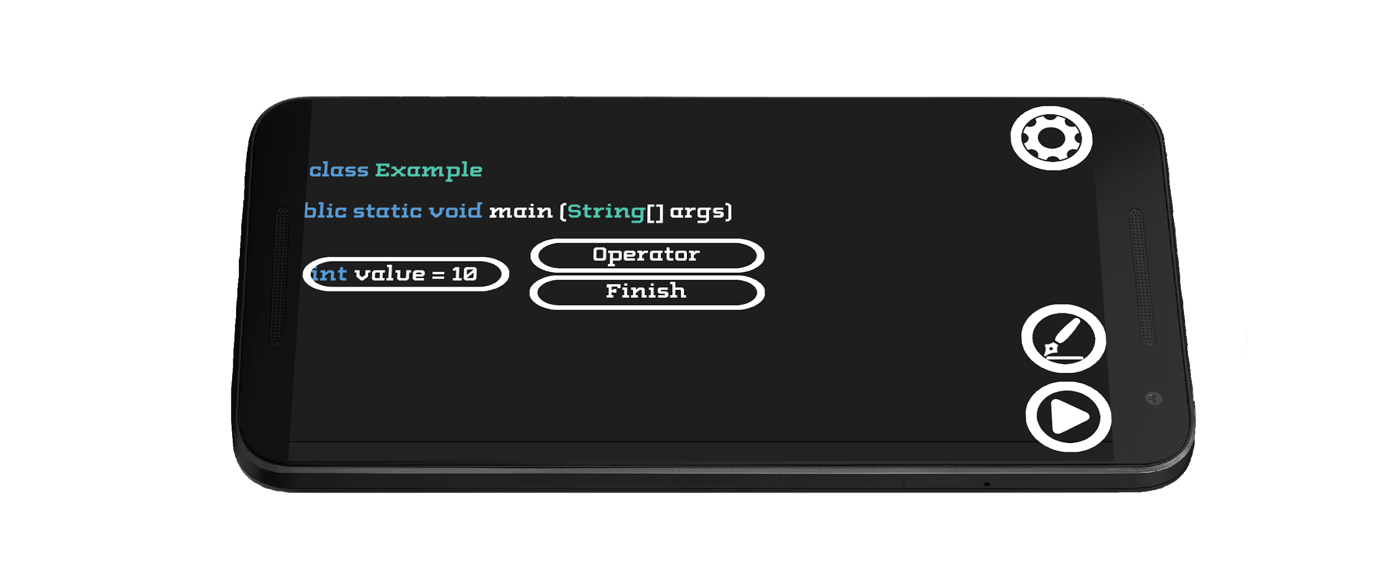
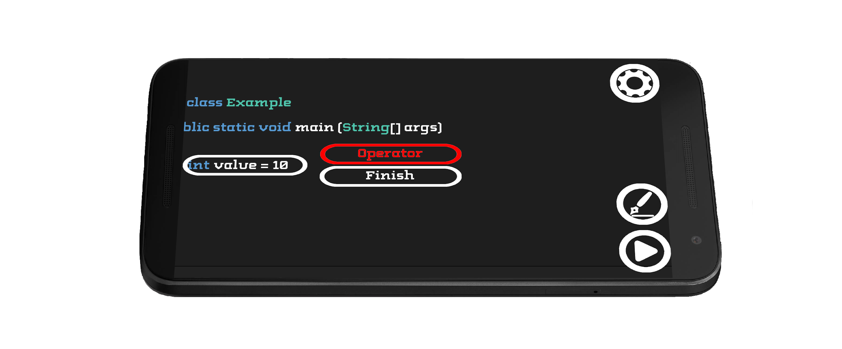
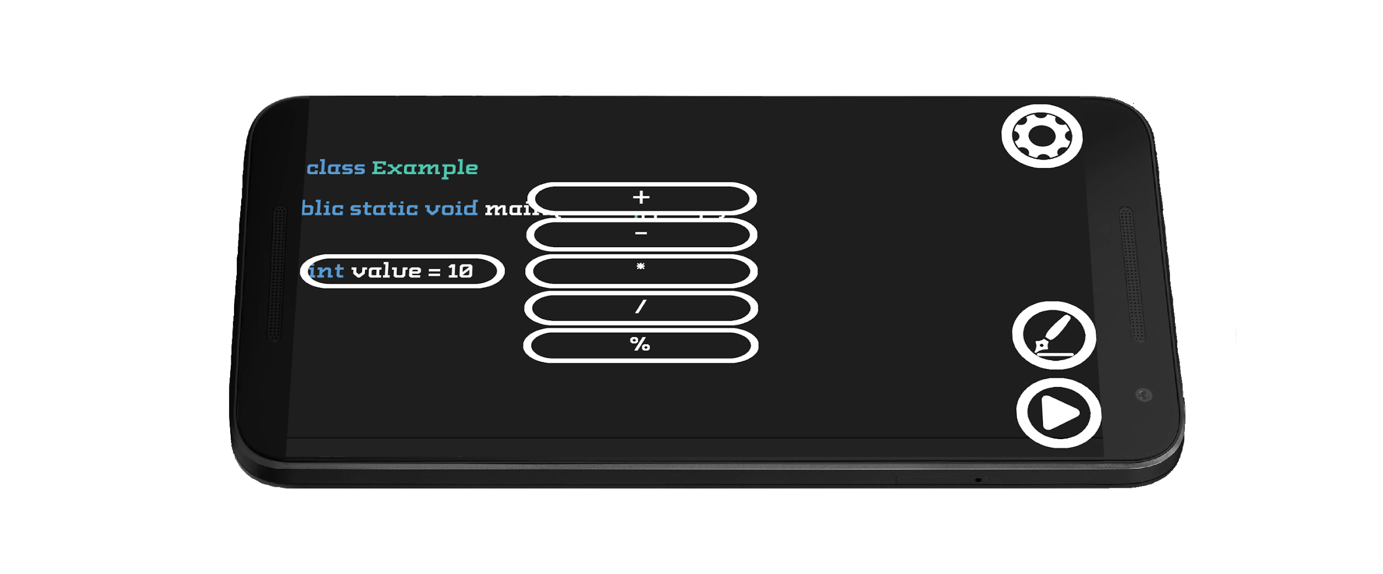
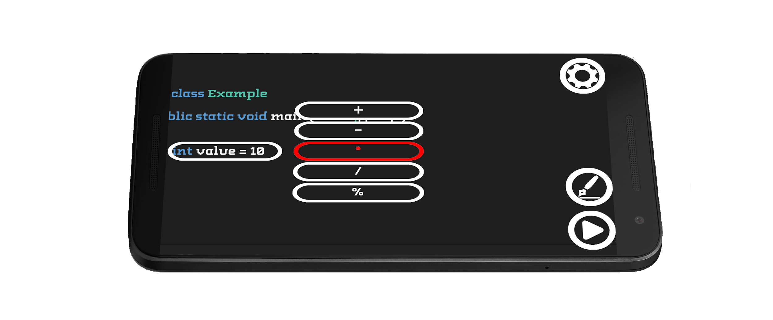
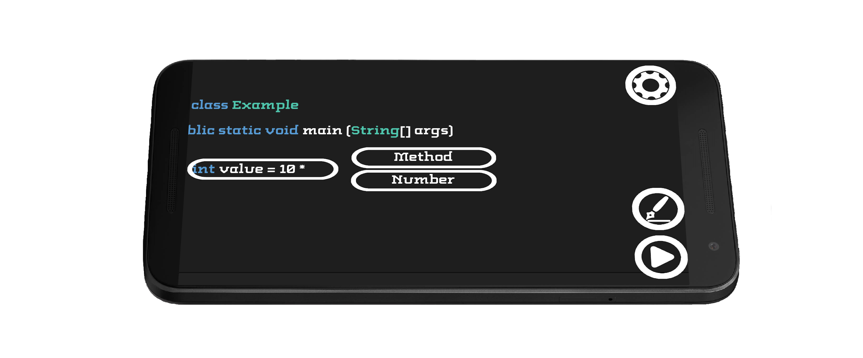
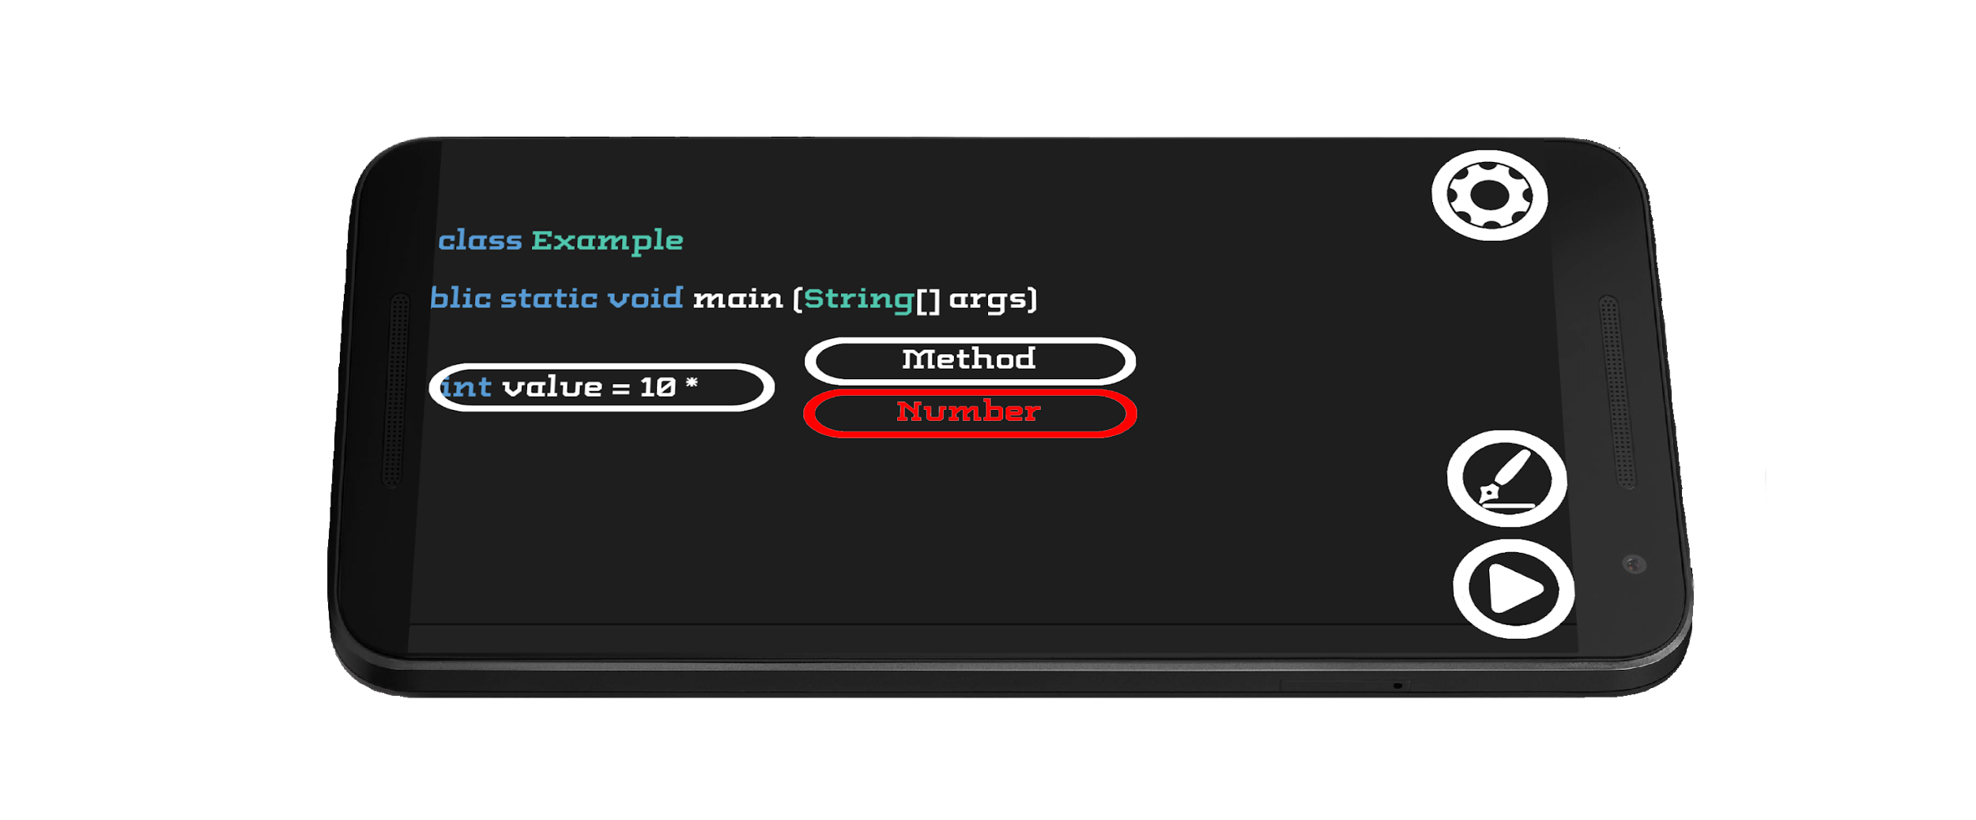



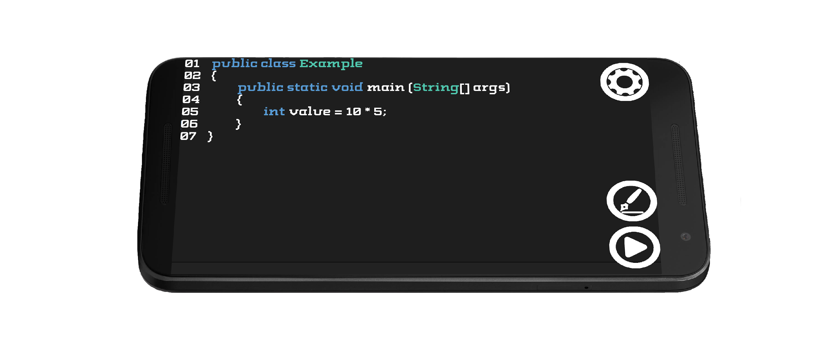
How does it work?
Notes:
Just like a sentence, a line of code is a structured unit. It has a subject (or variable), a verb (or modifier), and they work together to say something. Iterate lets students build lines of code like children learn to build sentences: one word at a time. By structuring it like this, we’ve eliminated the possibilities of typos or any other errors that plague so many new coders.

Slide 10
Benefits
Iterate and the curriculum behind it will go towards mitigating the gap in the supply and demand of CSE majors
Notes:
We aim to market this application to elementary and middle schools. Iterate (and the curriculum provided with it) allows students to learn at their own speed, with plenty of time to digest and play around with what they've mastered.
In the end, Iterate aims to make computer science a more palatable, inviting experience, taking away the intimidation that so many newcomers experience.

Slide 11
Final Thoughts
Notes:
Computer science isn’t for everyone. It takes a sort of masochist whose willing to stare at a computer screen for hours on end trying to find one little bug. But if we can bring people into the world of CSE and let them realize on their own how rewarding the experience can be, I think it will benefit everyone.
Even if you don’t think you have an interest in computer science, we invite you all to try out the app. We hope we can change your mind and make you realize just how fun programming can be.
Iterate: the Rosetta Stone of programming. Thank you.

